Slide 1
1.4.5 Fiber View Camera and
Fiducials
C. Baltay (Yale)
FVC L3 Manager
Directors Review
April 21, 2016

Slide 2
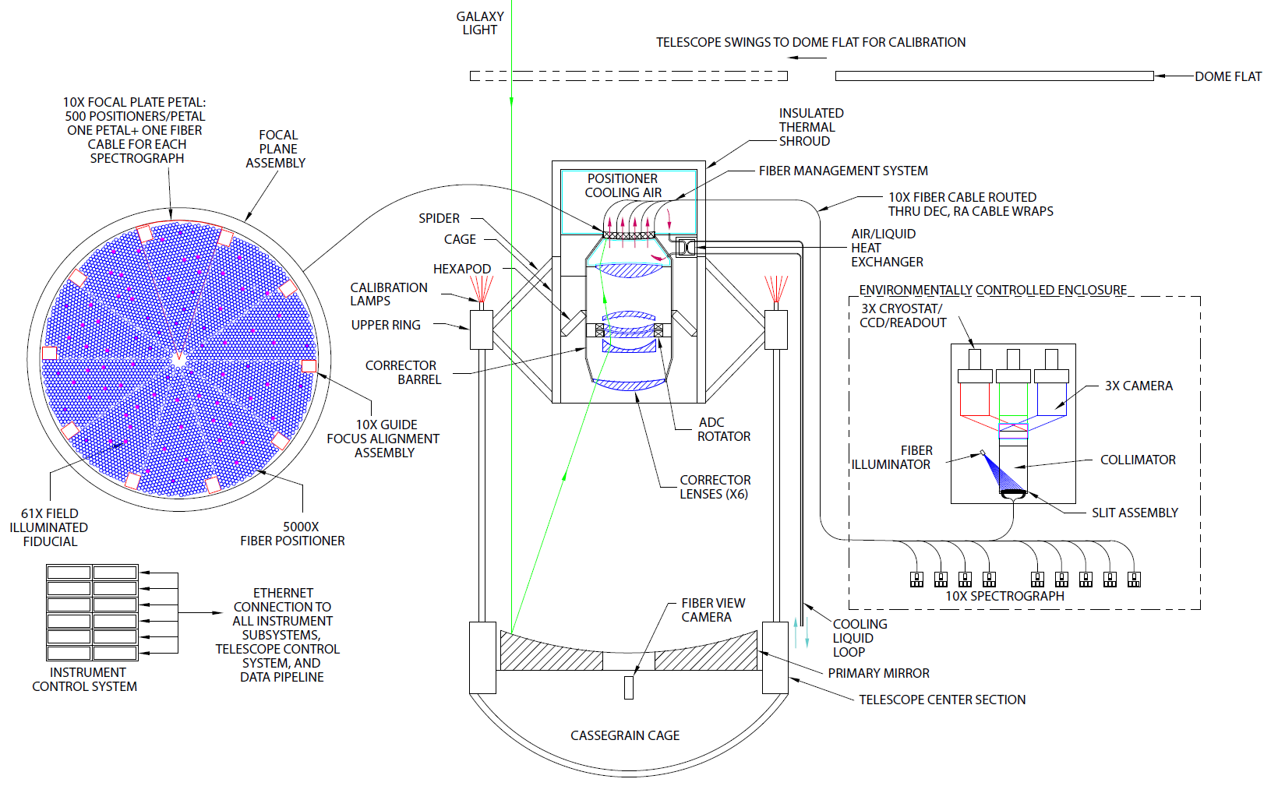
Fiber View Camera and Fiducials within the DESI System
FIDUCIALS
FIBER VIEW CAMERA

Slide 3
The DESI Fiber View Camera
Design
R&D Program and Prototype test results
Support Structure
Illuminated Fiducials
Budget and Schedule

Slide 4
The Function of the Fiber View Camera
5000 fibers on the fiber plane will be positioned to their desired positions by a computer controlled mechanism. The expected initial precision of the fiber positioners is expected to be 20 microns rms, 50 microns max. Fibers will need to be positioned to a 5 μm RMS accuracy using the Fiber View Camera.
The Fiber View Camera is designed to take an image of the fiber plane to measure the position of each fiber with a 3 μm RMS accuracy after the mechanism is done positioning them.
The positions of misplaced fibers can then be corrected based on the information from the Fiber View Camera.
Estimate is that one or two iterations will get fibers in the right positions

Slide 5
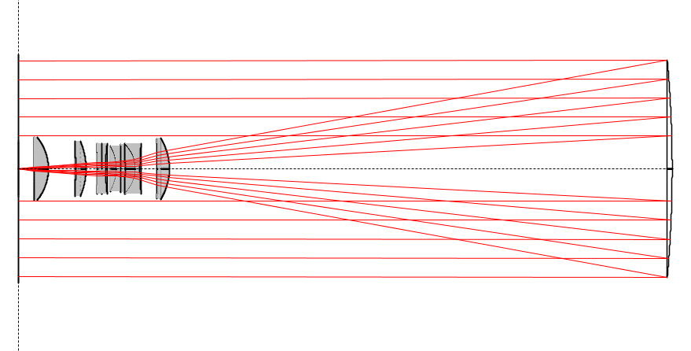
Location of the Fiber View Camera
Fiber Plane
Corrector Optics
Fiber View Camera
Fibers
12.25 m
Primary Mirror
LED
Spectrometer Enclosure

Slide 6
Fiber View Camera Requirements
Feature Requirement Present
CDR p. 123 Performance
Absolute Position Meas. 3 μm RMS 2.5 μm RMS
Nearest Neighbor Dist. < 1 mm 0.7 mm
Exposure Time < 2 sec 1 sec
Readout Time < 2 sec 5 sec*
Computing Time 1 sec < 1 sec
* Limited by USB cable between camera and computer, will be better with Ethernet cable and modified readout electronics of final camera

Slide 7
Design considerations
Input dimensions
  Fiberplane diameter is order of 830 mm
  CCD size ~37 mm
  Fiberplane to camera L = 12,250 mm
Demagnification desired ~ 25
Demag ~ f/L
Camera focal length f ~ 600 mm
At a demagnification of 25, a 5 micron precision on the fiber plane translates to 0.2 microns on CCD, or 1/30 of a 6 micron pixel (33 millipixels)

Slide 8
Fiber View Camera Design Specifications
CCD Kodak KAF-50100
Pixel Count 50 Mpix
Pixel Array 6132x8176
Pixel Size 6 µ x 6µ
Active Area 37mm x 49 mm
Quantum Efficiency 25%
Dark Current at 25⁰C 15 e/pix/sec
Read Noise 12.5 e
Read Out Time 1 sec
Lens Canon EF600mm f/4 L II USM
Focal length 600 mm
Aperture 150 mm
Demagnification 25
Electronics FLI Proline PL50100
Readout time ~1 sec
Focusing, aperture Computer controlled

Slide 9
Effects of the Corrector Optics
Ran beam traces using BEAM4 program, simulating images of the fiber plane through the corrector
Used the current baseline design of the corrector optics as input (E22, DESI-DOC-329)
Specifications for Canon and Nikon lenses not available. Found the specs for a 52 mm Tessar lens – scaled it to 600 mm focal length
Obtained acceptable images with this corrector and lens!!

Slide 10
Fiber View Camera R&D Plan Completed
Goal of the R&D Program was to demonstrate that the required 3 micron precision on the fiber position is achievable. To do this the plan was to:
  Design and build a prototype camera
  Design and build a test setup at Yale with a mock up of a portion of the fiber plane with fibers with precisely measured positions
  Carry out the test by imaging the mock fiber plane with the Fiber View Camera and analyzing the results

Slide 11
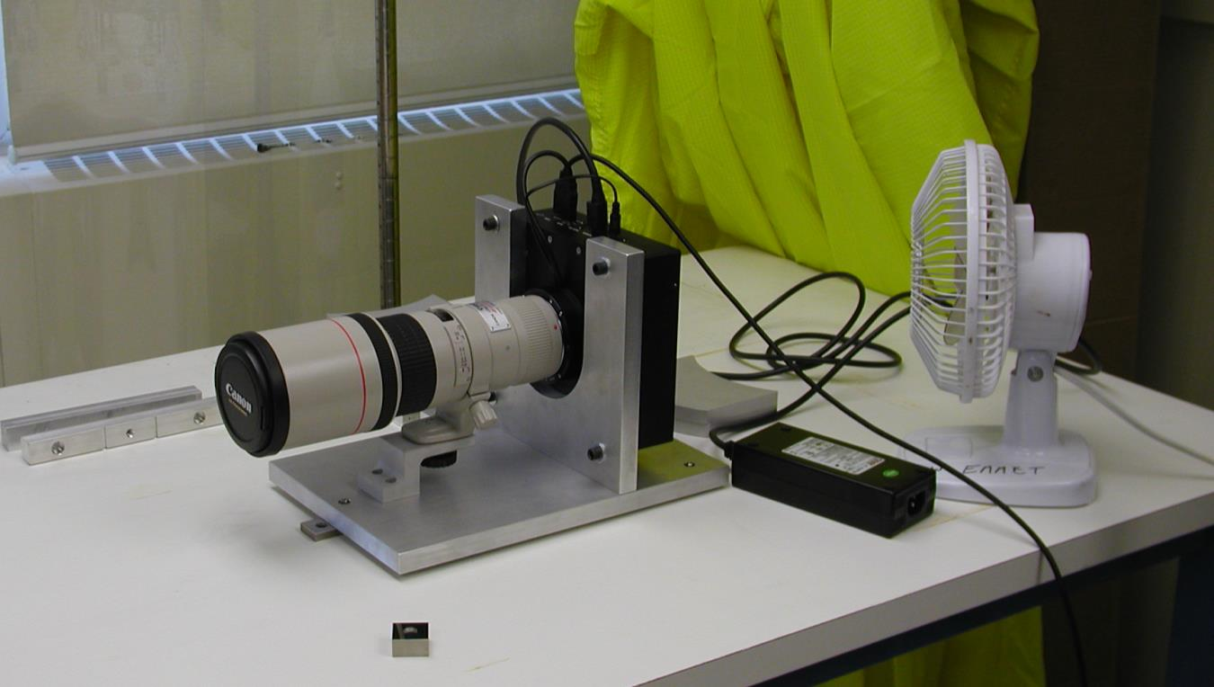
CCD, electronics, and lens have been assembled.
Completed May 1, 2012 with 400 mm lens.

Slide 12
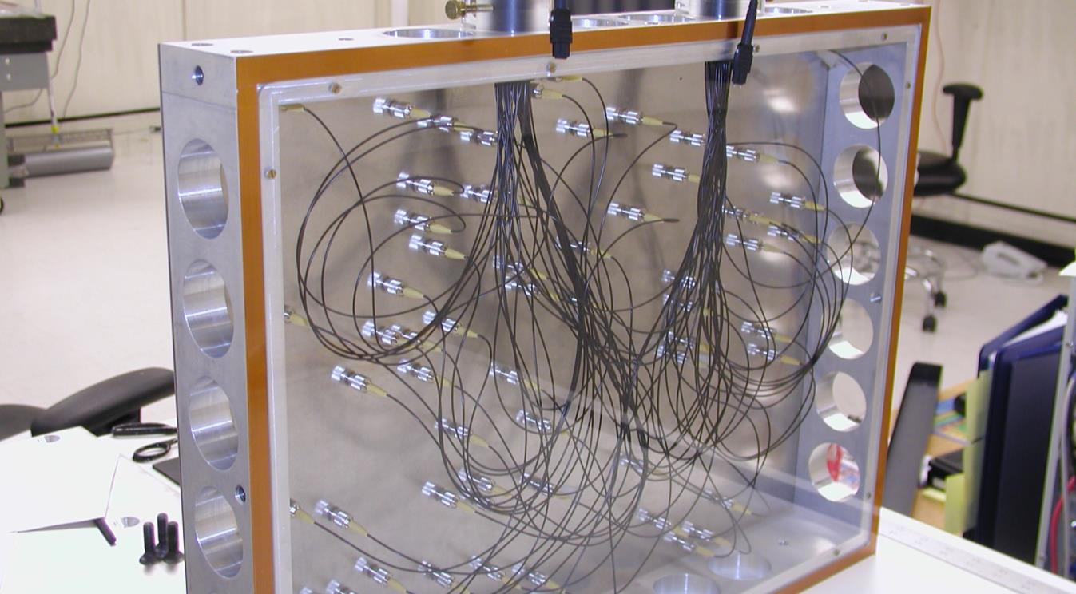
Fiber Plane Prototype – 64 fibers total

Slide 13
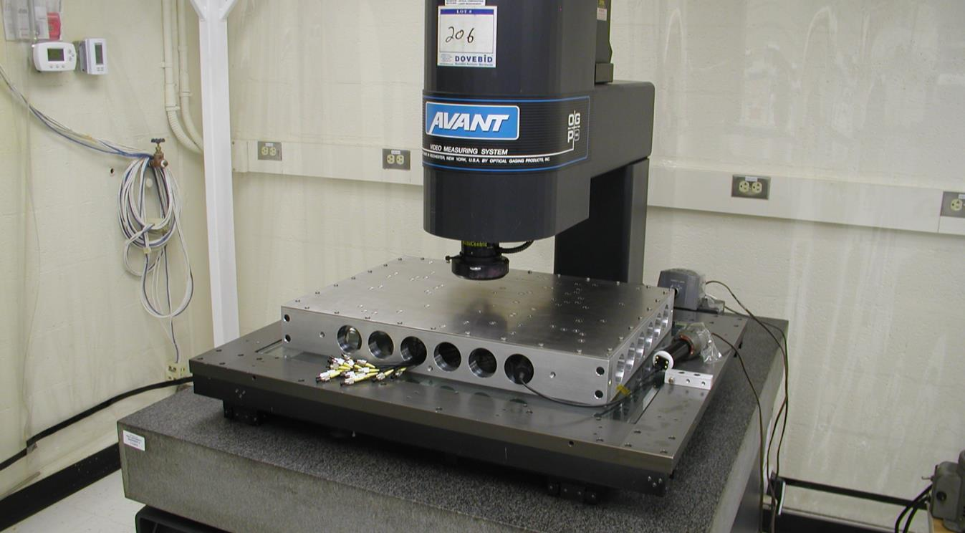
Precision Measuring Machine
Measured positions of the 64 fibers to a precision
of 1.5 microns to compare with the FVC images

Slide 14
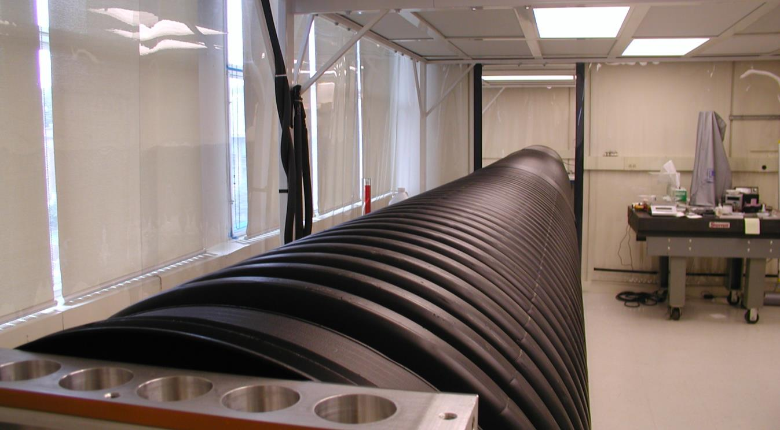
Sewer Pipe Light Baffle

Slide 15
Centroiding Position Error on CCD
Each entry is an exposure with 64 fibers
Xave = 13.0 millipixels
Yave = 14.3 millipixels
Number of Exposures
Millipixels on CCD

Slide 16
Centroiding Position Error on Fiber Plane
Each entry is an exposure of 64 fibers
Xave = 1.80 microns
Yave = 1.98 microns
Number of Exposures
3 micron
Goal
Microns on Fiber Plane

Slide 17
Fiber View Camera Mounting Bracket

Slide 18
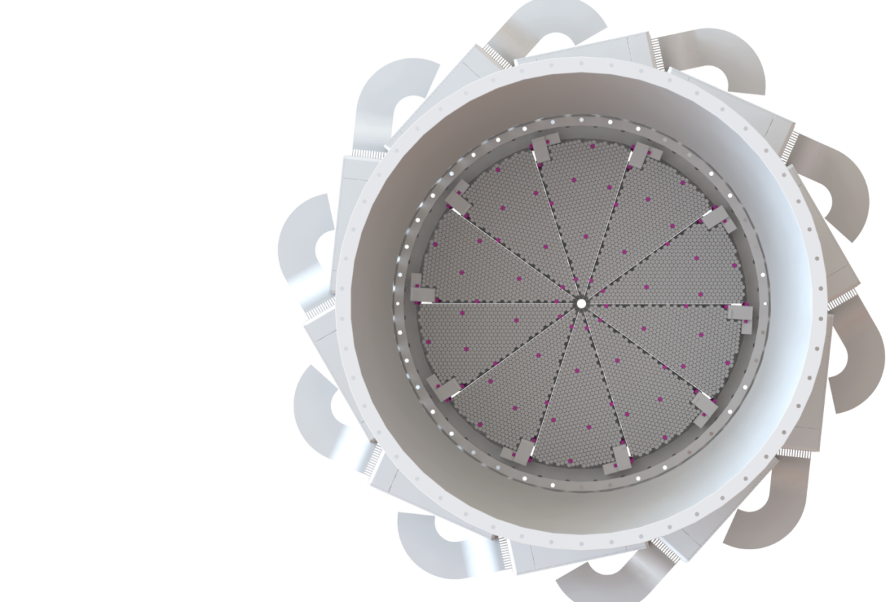
Illuminated Fiducial Fibers on the Fiber Plane
20 fiducials on the
GFA guide sensors
100 field fiducials on
the fiber plane

Slide 19
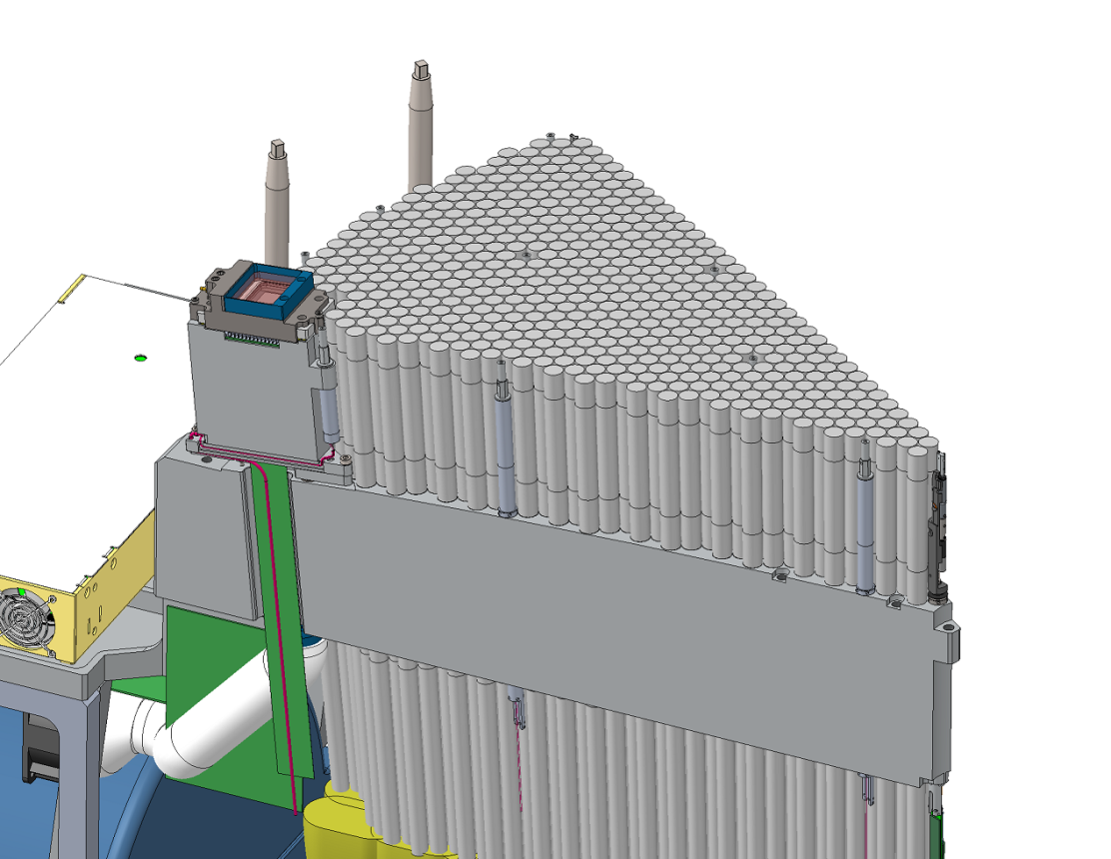
Focal Plane 1/10 Petal
GFA
Guider/Focus/Alignement
Joe Silber

Slide 20
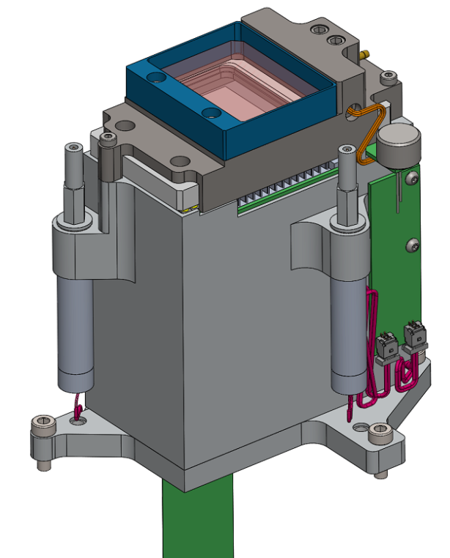
GIF (GFA illuminated fiducial)
DRIVER / COMM BOARD FOR THE TWO GIFS
GIF

Slide 21
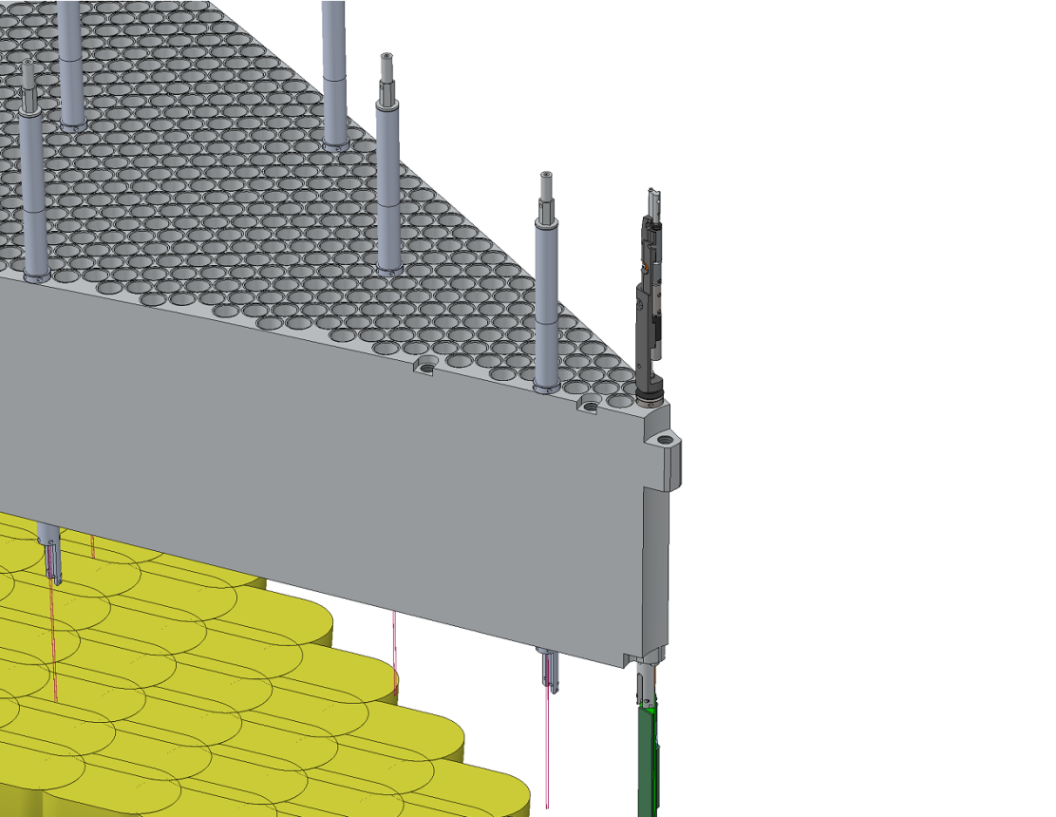
FIF (field illuminated fiducial)
Fiducial
Fiber Positioner

Slide 22
The heart of the illuminated fiducials
Three 10 micron diameter pinholes on surface of a glass block
Ground
glass
surface
3.5 mm dia
.
.
.
2.0 mm dia
Opaque blue
chrome finish
3 mm

Slide 23
Tip of the fiducials
Glass block
10 mW LED

Slide 24
Illuminated Fiber Plane Fiducial

Slide 25
Complete Fiber Plane Fiducial

Slide 26
Two Kinds of Fiducials
100 Fiber plane Fiducials - 10 per Fiber Plane Sector
Same size, mounting thread as positioners
20 GAF Fiducials - 2 on each GAF Camera
Identical Tip as Fiber Plane Fiducial, different mount

Slide 27
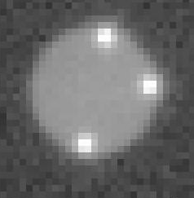
First Look at Fiducials
Inserted 5 finished fiducials into the fake fiber plane
we used for previous tests, took images at 12.25 meters
with FVC with 600 mm lens
Images of 3 pinholes clearly seen,
well separated
1.6 mm long leg of L
1.2 mm short leg of L
Background level on image
exagerated, is at less then
1% level of pinhole light

Slide 28
Reproducability of Fiducial Measurements
PRELIMINARY FIRST LOOK
Took 10 exposures of the 15 pinholes (5 fiducials, 3 pinholes each)
Each entry below is RMS of 10 measurements of each pinhole
xrms
yrms
X RMS
Y RMS
Microns on fiber plane
Microns on fiber plane
With 600 mm lens at 12.25 meters, demagnification 20

Slide 29
Reproducability of Fiducial Measurements
PRELIMINARY FIRST LOOK
Took 40 exposures of the 12 pinholes (4 fiducials, 3 pinholes each)
Each entry below is RMS of 10 measurements of each pinhole
xrms
xrms
yrms
yrms
X RMS
Y RMS
Microns on fiber plane
Microns on fiber plane
With 100 mm lens at 2 meters, demagnification 20

Slide 30
Fiber View Camera Key Personnel
A collaborative effort between LBNL and Yale University
  C. Baltay, W. Emmet, N. Padmanabhan, Terry Girard*, Dana Cassetti*, Yale
  R. Besuner, M. Lampton, and J. Silber, LBNL
  *members of Prof. Bill Van Altena’s precision astrometry group at Yale

Slide 31
Fiber View Camera and Fiducials – Schedule
Milestone | Date
Prototype Camera with 70-200 mm lens delivered to LBNL | April 1 , 2016
5 prototype fiducials delivered to LBNL | April 1, 2016
25 fiducials delivered to LBNL (12 for Proto-DESI,10 for Sector 1) | April 25, 2016
Final Fiber View Camera complete at Yale | May 31, 2016
Lab Tests at Yale with final camera, final fiducials | June 2016
Deliver Final FVC, 600 mm lens,support structure to Mayall tel | July 1,2016
Deliver 120 final fiducials + spares to LBNL | October 1, 2016

Slide 32
All 1.4.5 costs are non-Project funded

Slide 33
Summary and Conclusions
The Fiber View Camera R&D Program has been successfully completed
  Demonstrated that we can achieve required precision
  Analysis program done, reached desired 1 second processing time
  Anticipate no changes in the final design
  Parts for final camera on order, identical to prototype but with ethernet connection to computer to achieve a shorter readout time, and 600 mm lens, will keep prototype camera as spare

Slide 34
Summary and Conclusions
Illuminated Fiducials
  Have detailedl design of both the focal plane fiducials and the GFA fiducials
  First few prototypes completed
  Preliminary test show prototype fiducials performance good
  Need to test prototypes both in lab at Yale and in proto-DESI
  Team to finalize design and fabricate fiducials in place at Yale

Slide 35
Backup slides

Slide 36
CCD Choice
Considered 4 Frontside Illuminated, Monochrome Sensors
CCD | Array | Pixel Size | Price
Kodak KAF-50100 | 6K x 8K | 6 μ x 6 μ | 5 K$
DALSA FTF-6080M | 6K x 8K | 6 μ x 6 μ | 25 K$
BAE (Loral) CCD-595 | 9K x 9K | 9 μ x 9 μ | 55 K$
STA STA-1600A | 10K x 10K | 9 μ x 9 μ | 50-60 K$

Slide 37
Lens Choice
Lens | Field of View | Resolution | Price
Canon EF 600mm f/4L USM | 6 º | 125 lines/mm | 13 K$
Canon EF 400mm f/5.6 DO IS USM | 6º | 125 lines/mm | 1.3 K$
Canon EF 400mm f/2.8 L IS II USM | 6º | Better then the f/5.6 | 11.5 K$
Schneider Apo-Tele-Xenar 400mm f/5.6 | 29º | 50 lines/mm | 2.4 K$
Rodenstock Apo-Sironar S 360mm f/6.8 | 40º | 76 lines/mm | 4.4 K$

Slide 38
Electronics and Package Choice
Camera | CCD Used | Array/Pixels | Price *
FLI Proline PL50100 | Kodak KAF 50100 | 6K x 8K/ 6μ | 21K$
Illunis RMV-50M | Kodak KAF 50100 | 6K x 8K/ 6μ | 30K$
Spectral Instr 1100S | Kodak KAF 50100 | 6K x 8K/ 6μ | 40K$
Spectral Instr 1110S | Loral CCD 595 | 9K x 9K/ 9μ | 150K$
STA Custom Camera Mega-Vision E7 Cam Back | STA 1600A Kodak KAF 50100 | 10K x 10K/ 9μ 6K x 8K/ 6μ | 75 – 150K$ 24K$
* Prices include the CCD

Slide 39
In Situ Calibration
It will be important to calibrate the camera during the operation of the survey with each exposure using fixed illuminated fiducial on the focal plane.
Plan on using 100 fixed illuminated fiducials
Calibration uses 3rd order polynomial
  X = a₁+a₂x+a₃y+a₄xy+a₅x²+a₆y²+a₇x³+a₈y³+a₉x²y+a₁₀xy²
  Y = b₁+b₂x+….
Will need precision measurements of the fiducial positions before installation of the fiber plane.
Also plan to have fiducials on the ten Guide/Focus/Alignment (GFA) sensors on the periphery of the focal plane which will be imaged on the Fiber View Camera

Slide 40
Dependence on the Number of Fiducials
Used real data of 36 exposures with the Fiber View Camera with 64 fibers each. Selected 16 fibers as fiducials to fit the 10 coefficients in x and 10 coefficients in y in the third order polynomial transformation for each exposure. Found the resolution on the fiber plane for the remaining fibers not used as fiducials to be about 2.5 microns.
Repeated using N fibers as fiducials with N from 16 to 48. With N above 30 or so resolution of the non-fiducial fibers approached 2.0 microns, as good as we have ever seen.
With only 64 fibers the number of non fiducial fibers becomes small as N is larger( 14 for N=48) so statistics not terrific.

Slide 41
Dependence on the Number of Fiducials
Simulated 5000 fibers on full 95 cm dia fiber plane
  Divided fiber plane into 5000 fiber areas on hex pattern
  Picked random location for each fiber in its area. These were the “TRUE” fiber center locations
  Mapped fiber positions onto CCD plane by 3rd order polynomial transformation similar to actual lens/camera transformation
  Spread fiber positions randomly by 13 millipixels on CCD (this corresponds to 1.9 microns on fiber plane)
Chose N fibers as fiducials, used these fiducials to obtain 3rd order polynomial to transform fibers to fiber plane
  X = a1+a2x+a3y+a4xy+a5x2+a6y2+a7x3+a8y3+a9x2y+a10xy2
  Y = b1+b2x+….
Compared these transformed positions to the known starting “TRUE” positions

Slide 42
Resolution on Fiber Plane vs. no of Fiducials
RMS on fiber plane, microns
Number of fiducials N

Slide 43
Fiber Separation Study
Measured resolution on the fiber plane for simulated
fibers at various separations, 20 at each separation
0.75mm x 1/25 demag=30μ on CCD
30μ on CCD=5 pixels=3 image FWHM
Resolution on fiber plane(μ)
2 μ
Center to center fiber separation (mm)

Slide 44
Dependence on the Flux
2 ADU counts = 1 electron
FWHM/√N
Resolution on fiber plane (microns)
Flux in image (units of 10³ ADU counts)

Slide 45
Dependence on the Flux
There is a wide plateau between 20,000 and 80,000 ADU counts that give resolution better the 2.5μ at f/16.
With 2 ADU counts/electron this means between 10,000 and 40,000 e per image on CCD, so 25,000 is a good guess of where we should be.

Slide 46
Possible Effect of Turbulence
Did one test to simulate turbulence in the Mayall telescope
Opened shades on windows, let the sunshine in. This heated up the sunnyside of the sewer pipe by up to 5ºC
Took 20 exposures at ΔT = 1ºC and at ΔT = 5ºC
No significant increase in the image FWHM at f/16
f stop | Previous resolution | ΔT = 1ºC | ΔT = 5ºC
f/16 | 2.22 μ | 2.06 μ | 2.49 μ

Slide 47
Fiber Illumination Input Angle
No effect on resolution on fiber plane
Illumination Angle | σ (x) microns | σ (y) microns
Sideways (4 exposures) | 2.09 | 2.35
Normal (6 exposures) | 2.11 | 2.47
Sideways (4 exposures) | 2.15 | 2.08

Slide 48
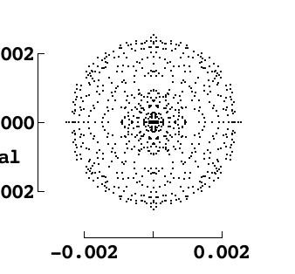
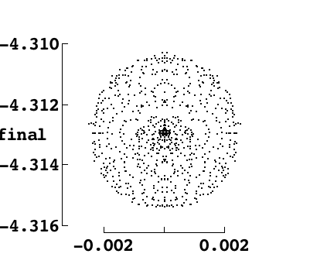
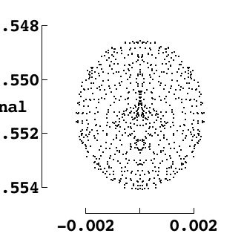
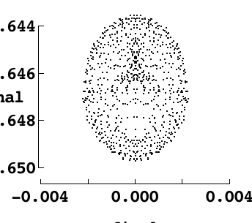
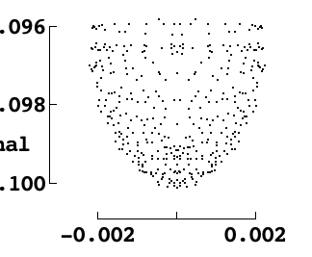
Image Shapes at various Radii
R = 100
R = 200
R = 0
-8
X
X
X
-8
-8
-8
Y
Y
Y
R = 300
R = 415
-12
-17
X
-12
X
-17
-12
-17
-12
Y
Y
Not including diffraction effects
16

Slide 49
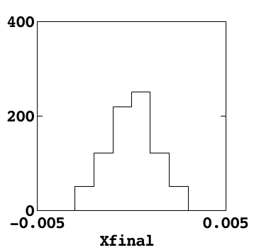
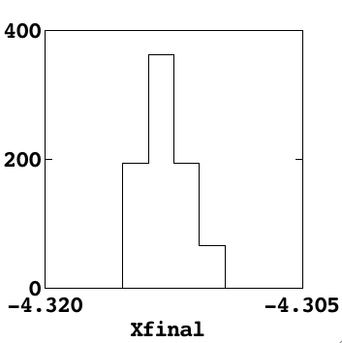
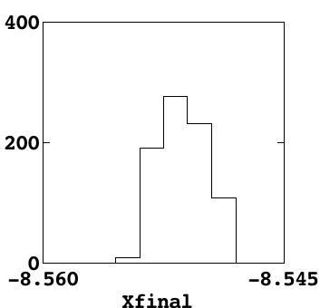
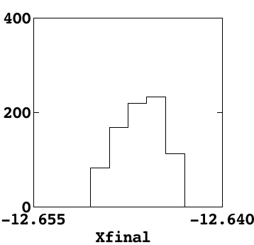
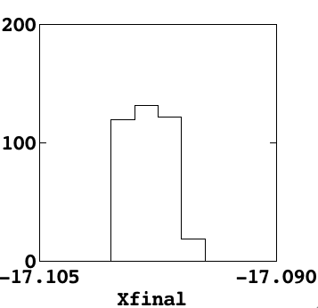
Radial Image Sizes
R = 0
R =100
R = 200
R = 300
R = 415

Slide 50
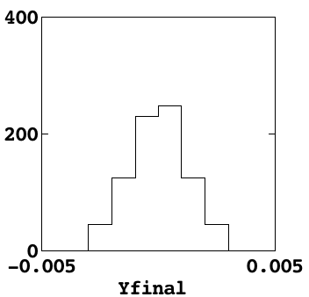
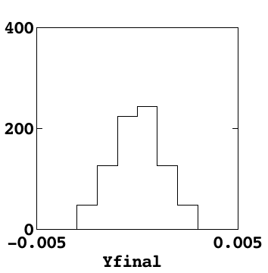
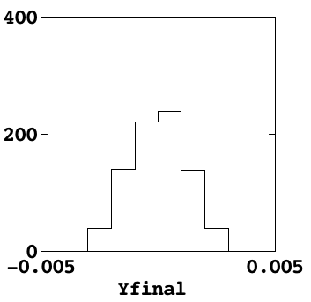
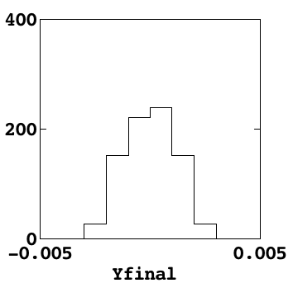
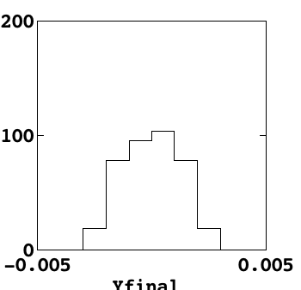
Image Sizes in Azimuth
R = 0
R = 100
R = 200
R = 300
R = 415

Slide 51
FVC Time Sequence Goals
Will develop the electronics, computers and
software to control the Fiber View Camera In the
context of the overall Telescope Control System.
Activity | Time Required
Exposure time | 1 second
Camera readout | 1 second
Centroid calculation | 1 seconds
Total per Iteration | 3 seconds

Slide 52
Dependence on FWHM of image on CCD
Resolution on Fiber Plane (μ)
Image FWHM on CCD (pixels)

Slide 53
Depth of Field at Various f stops, at λ = 600 nm
Diffraction spot size = λ x fno =10 μ = 1.6 pixels
for monochromatic light with λ = 0.6 μ and f/16
FWHM on CCD (pixels)
Focus (object distance in cm)

Slide 54
Diffraction Limit vs. fstop, 400 mm lens, 600nm λ
Parameter | f/5.6 | f/10.4 | f/16
Aperture dia d | 71 mm | 38 mm | 25 mm
δΘ = λ/d | 8.5x10⁻⁶ rad | 15.6 x 10⁻⁶ rad | 24 x 10⁻⁶ rad
f x δΘ | 3.4 μ | 6.2 μ | 9.6 μ
Image size(pixls) | 0.6 | 1.0 | 1.6
Minimum image size due to diameter of the fibers:
120 μ de-magnified by 25 gives 4.8 μ image diameter
or 0.8 pixels on CCD. We realized this early on
and said that we would have to defocus the image.
The diffraction limit at f/16 is doing this for us over
a wide range of focus positions, making f/16 very
robust. At lower f stops things get more delicate…

Slide 55
Diffraction Limit vs. fstop for 600 mm lens, 470 nm λ
Parameter | f/8 | f/16 | f/22
Aperture dia d | 75 mm | 38 mm | 27 mm
δΘ = λ/d | 6.3x10⁻⁶ rad | 12.5 x 10⁻⁶ rad | 17.4 x 10⁻⁶ rad
f x δΘ | 3.8 μ | 7.5 μ | 10.4 μ
Image size(pixls) | 0.6 | 1.2 | 1.7
Minimum image size due to diameter of the fibers:
120 μ de-magnified by 25 gives 4.8 μ image diameter
or 0.8 pixels on CCD. We realized this early on
and said that we would have to defocus the image.
The diffraction limit at f/22 is doing this for us over
a wide range of focus positions, making f/22 very
robust. At lower f stops things get more delicate…

