Slide 1
Progress and Plans
Fiber View Camera and Fiducials
C Baltay
Sept 22, 2015

Slide 2
FVC Support Strtucture Design
We are ready to cut metal

Slide 7
New Camera
Plan is to use the existing Prototype camera for Proto-DESI, so no rush to purchase new camera
However started discussions with FLI for new camera
Will get air-cooled version (will not need chilled water at FVC location)
Plan on faster readout, approaching 1 second
  Discussions with FLI right now about best option
  Ethernet, gigabit, USB3,…cable,
  4 readout streams 12 Mpixels/sec each (6Kx8K CCD ~ 50 Mpixels)
  Should we readout 6Kx6K only?

Slide 8
New FVC Lens
Plan to purchase 600 mm lens October 2015
  Canon EF 600 mm f/4 L ISII USM
Needed for FVC located 12.25 meters from focal plane

Slide 12
Pinholes on glass diffuser block

Slide 13
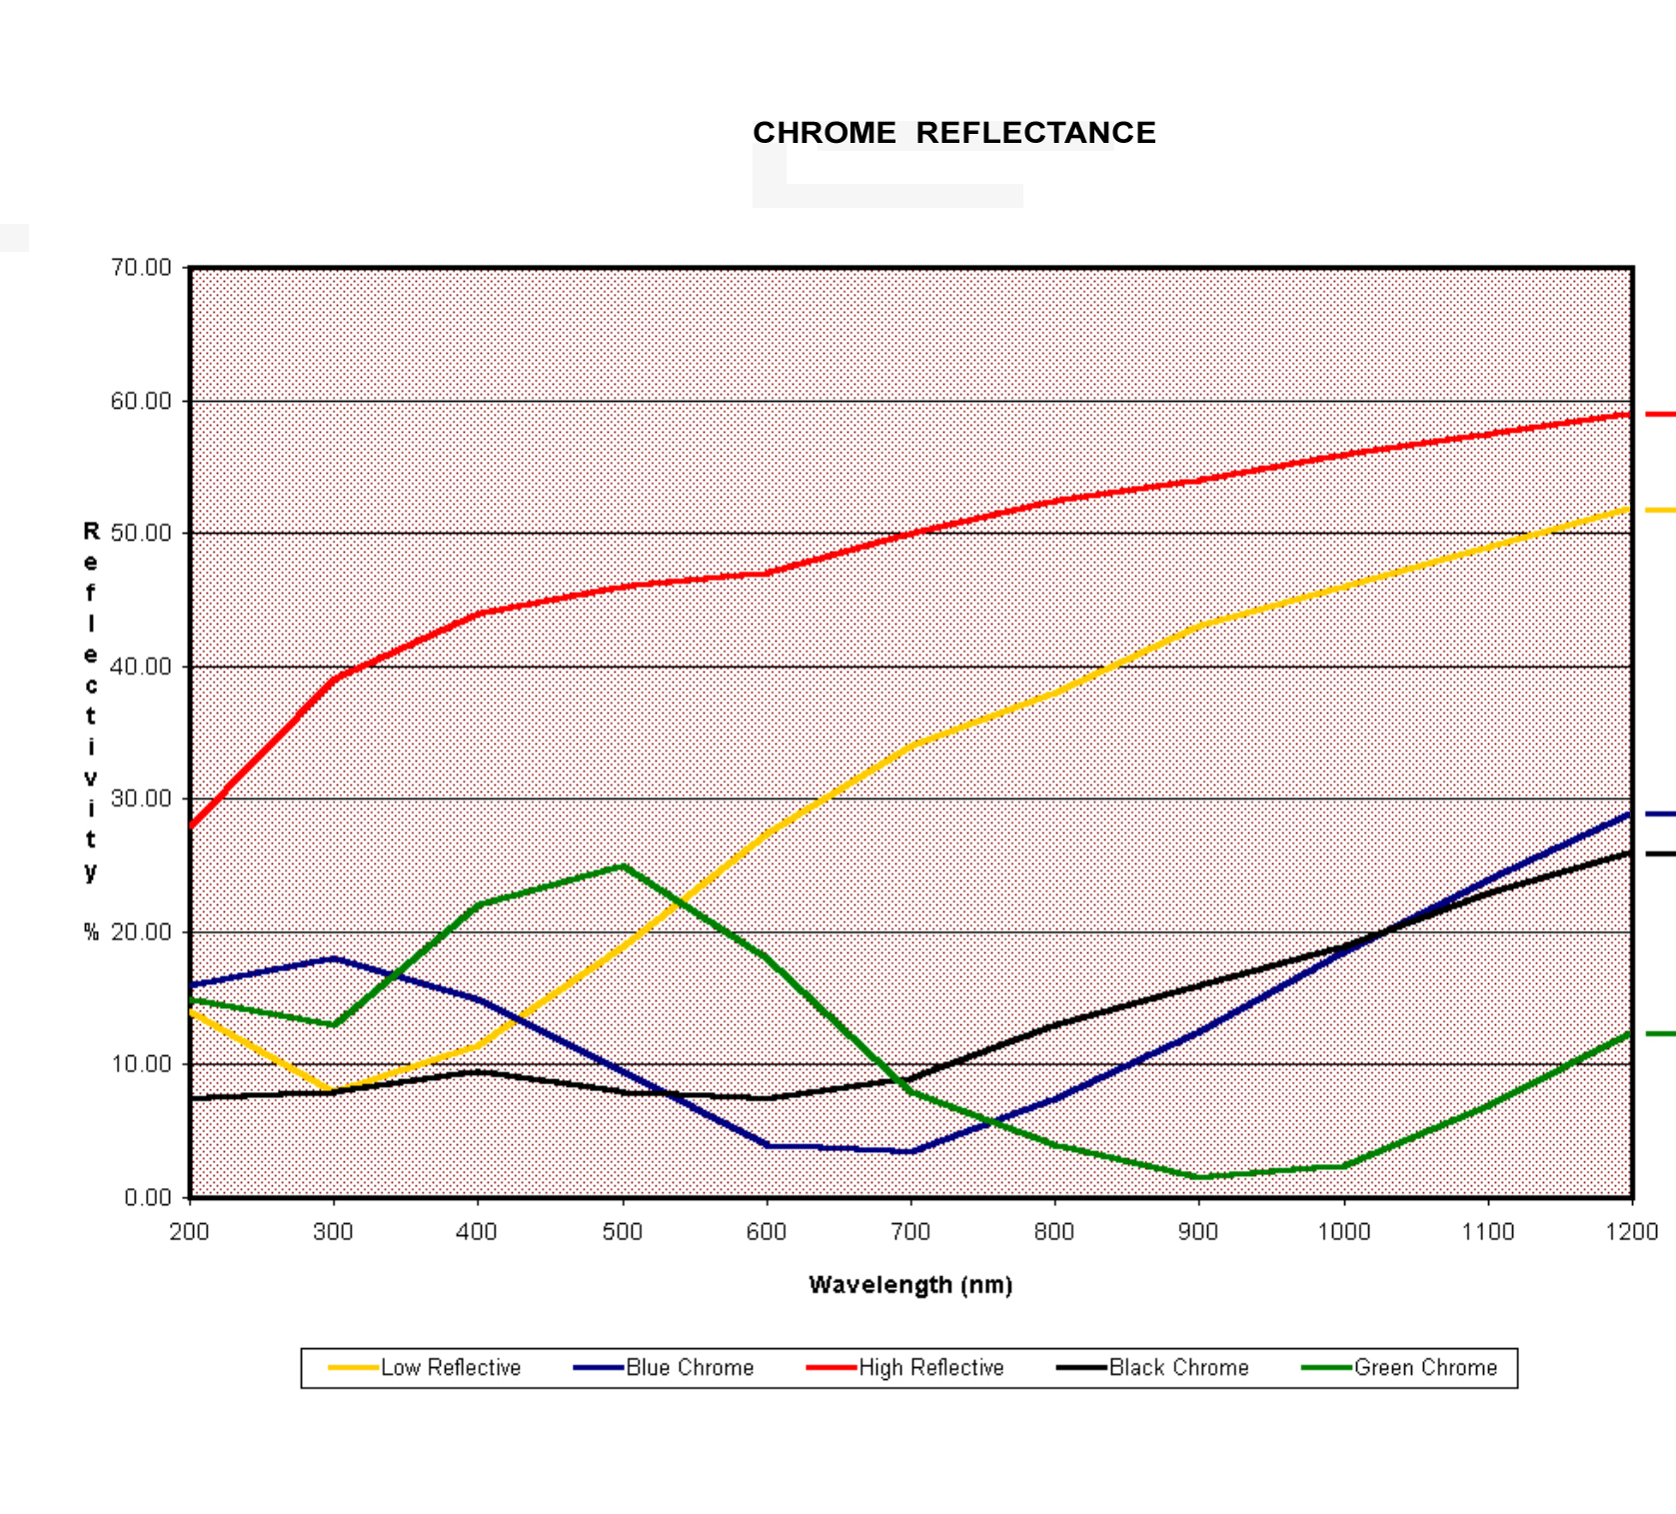
Reflectivity of chrome finishes
Blue Chrome
Black Chrome

Slide 14
Pinhole Glass Block
Sent Request for bid to three suppliers
  Applied Image Inc
  Optics Balzers
  Pixel Tech
All three said they can do it, waiting for bids with price and delivery times for
  15 pieces right away
  150 later

Slide 15
LED Illumination
Plan to use Wurth Electronics 151033BS03000 LED
470 nm wavelendth
LED 30 mm from ground glass surface
Mike Lampton estimates 198,000 electrons per fiducial image on CCD in a 1 sec exposure
Would like 25,000 (acceptable range 10,000 to 40,000)
Can turn down voltage on LED or shorten FVC exposure time or flash LED for shorter time

Slide 16
Dependence on the Flux
2 ADU counts = 1 electron
FWHM/√N
Resolution on fiber plane (microns)
Flux in image (units of 10³ ADU counts)

Slide 17
Mike Lamptons Light Estimate

Slide 18
Mike Lamptons Light Estimate

Slide 19
Final Test Plan
Expect to have new 600 mm lens, and first batch of prototype fiducials in hand by November or December of this year
Will insert prototype fiducials into the fake fiber plane with 64 fibers
Will measure position of fiducials with Yale high precision measuring machine we used in previous tests
Will setup FVC camera 12.25 meters from fiber plane and take exposures (old sewer pipe and lab room were 8 meters. Will setup in long corridor and do exposures at night)
Using the precisely known positions of the 64 fibers will see how accurately we can reproduce the centroids of the pinhole fiducials

