Slide 1
A Brief History of Mass and The (likely) Discovery of the Higgs
Paul Tipton, Yale University
St Thomas More Chapel, Sept. 30, 2012

Slide 2
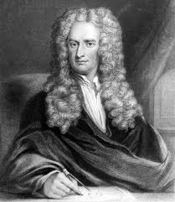
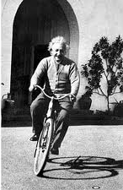
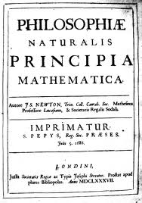
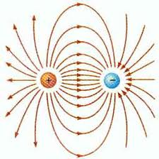
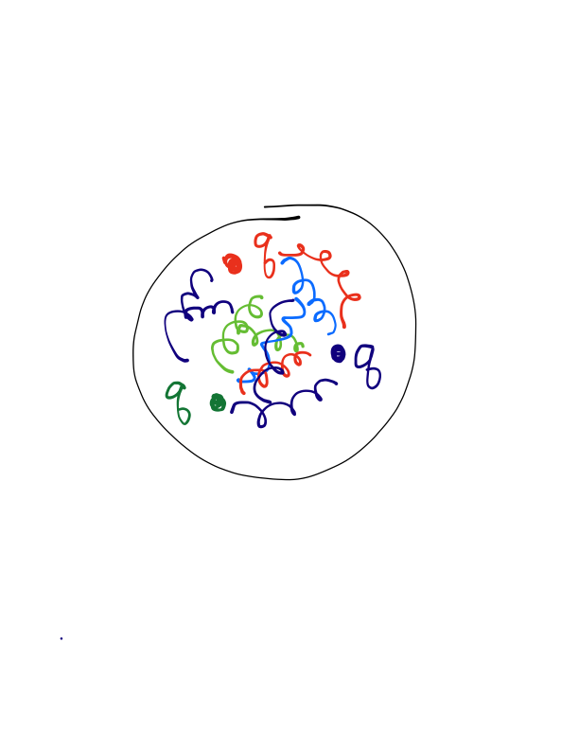
A Brief History of Mass
Newton (1687) and his mechanics, Lavoiser (1760)
Mass is an inherent essential property of an object
It is conserved, neither created or destroyed
After Einstein and Quantum Mechanics
Both light and building-blocks of matter (quarks and leptons) are quantized oscillating massless fields.
Particles interact by exchanging other force-mediating particles
Flaw in theory: Why aren’t fundamental
Particles massless like light?
The Fix: Add a ubiquitous Higgs field
Mass arises via a dynamical interaction with the Higgs field
The Higgs field self-interacts give the Higgs Boson
Most mass arises dynamically within the proton
swarms of gluons around quarks

Slide 3
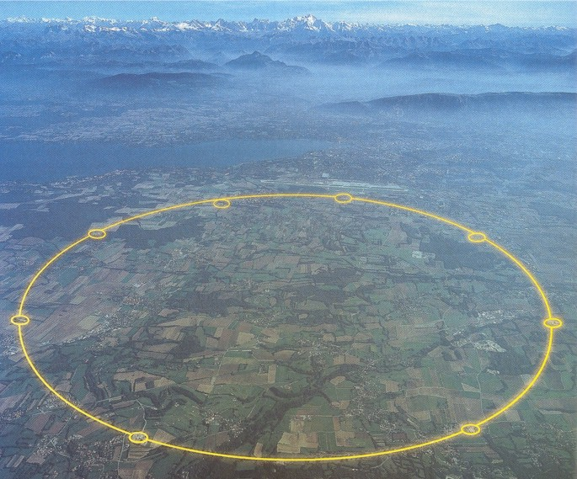
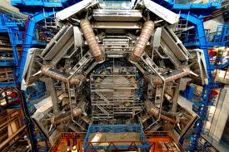
Finding the Higgs
The Higgs Boson is very unstable
Can’t find one, need to create it with an accelerator
(run E=mc² ‘backwards’, turn energy into matter)
The accelerator is the LHC
We detect the Higgs by observing its decay products
This summer we discovered a ‘Higgs-like object’
Is produced like the Higgs should be produced
Decays like the Higgs should decay (roughly)
Mass in the allowed range (constrained by other experiments)

Slide 4
What it all means (my opinion)
Science Lessons:
We have a (relatively) `complete’ the picture of mass:
Mass is beautifully complicated and elegantly revealed in Quantum Mechanics:
In ~1810, matter was real, fields were math
Now everything is comprised of quantized fields
Mass is dynamic in origin, not innate. It arises from fundamental interactions and is calculable (at some level)
Last puzzle piece, Higgs Boson; intellectual & experimental tour-de-force
I

Slide 5
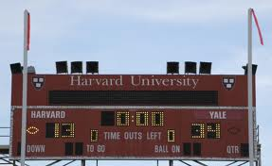
What it all means (my opinion)
Beyond the Science:
The higgs discovery was global, publically supported
International Cooperation 1 Nationalistic Rancor 0
Glory & Virtue of Taxation 1 Hyper Individualism 0
Practically all taxpayers on the planet had skin in the game
Higgs Boson 1 icrosoft Boson 0
Human Curiosity trumped all else
Human Curiosity 1 Motives lower on Maslow's hierarchy 0
Opportunity Cost
End to Preventable Disease 0 Big Science 1

