Slide 1
The DESI Fiber View Camera
and Fiber Plane Fiducials
C Baltay
March 26, 2015
1

Slide 2
Fiber View Camera Key Personnel
A collaborative effort between LBNL and Yale University
C. Baltay, W. Emmet, N. Padmanabhan, B. Horowitz, Terry Girard*, Dana Cassetti*, Yale
R. Besuner, M. Lampton, and J. Silber, LBNL
*members of Prof. Bill Van Altena’s precision astrometry group at Yale

Slide 3
The Function of the Fiber View Camera
5000 fibers on the fiber plane will be positioned to their desired positions by a computer controlled mechanism. The expected initial precision of the fiber positioners is expected to be 20 microns rms, 50 microns max. Fibers will be positioned to a 5 μm RMS accuracy using the Fiber View Camera.
The Fiber View Camera is designed to take an image of the fiber plane to measure the position of each fiber with a 3 μm RMS accuracy after the mechanism is done positioning them.
The positions of misplaced fibers can then be corrected based on the information from the Fiber View Camera.
Estimate is that one or two iterations will get fibers in the right positions

Slide 4
The DESI Fiber View Camera
Design
Prototype test results
Support Structure
Illuminated Fiducials

Slide 5
Location of the Fiber View Camera
Fiber Plane
Corrector Optics
Fiber View Camera
Fibers
12.25 m
Primary Mirror
LED
Spectrometer Enclosure

Slide 6
Fiber View Camera Requirements
Feature Requirement Present
CDR p. 123 Performance
Absolute Position Meas. 3 μm RMS 2.5 μm RMS
Nearest Neighbor Dist. < 1 mm 0.7 mm
Exposure Time < 2 sec 1 sec
Readout Time < 2 sec 5 sec*
Computing Time 1 sec < 1 sec
* Limited by USB cable between camera and computer,
will be 1 sec with ethernet cable and modified
readout electronics

Slide 7
Some Design considerations
Input dimensions
Fiberplane diameter is order of 830 mm
CCD size ~37 mm
Fiberplane to camera L = 12,250 mm
Demagnification desired ~ 25
Demag ~ f/L
Camera focal length f ~ 600 mm
At a demagnification of 25, a 5 micron precision on the fiber plane translates to 0.2 microns on CCD, or 1/30 of a 6 micron pixel (33 millipixels)
A bit of history-Nov 2013 had the FVC obove the primary mirror, 8.9 meters from fiber plane with a 400 mm lens

Slide 8
Fiber View Camera Design Specifications
CCD Kodak KAF-50100
Pixel Count 50 Mpix
Pixel Array 6132x8176
Pixel Size 6 µ x 6µ
Active Area 37mm x 49 mm
Quantum Efficiency 25%
Dark Current at 25⁰C 15 e/pix/sec
Read Noise 12.5 e
Read Out Time 1 sec
Lens Canon EF600mm f/4 L II USM
Focal length 600 mm
Aperture 150 mm
Demagnification 25
Electronics FLI Proline PL50100
Readout time 1 sec
Focusing, aperture Computer controlled

Slide 9
Effects of the Corrector Optics
Ran beam traces using BEAM4 program, simulating images of the fiberplane through the corrector
Used the current baseline design of the corrector optics as input (E22, DESI-DOC-329)
Specifications for Canon and Nikon lenses not available. Found the specs for a 52 mm Tessar lens,
scaled it to 600 mm focal length
Obtained acceptable images with this corrector and lens!!

Slide 10
Ray Traces to the Fiber View Camera
Fiber Plane
Fiber View Camera
Corrector Optics

Slide 11
Corrector Optics
Curved Fiber Plane
Curved Fiber Plane

Slide 12
The Fiber View Camera
Using BEAM4 Ray tracing program to design and check optics
600 mm Tessar Lens
Kodak 6K x 8K CCD

Slide 13
Results of the Ray Traces
R on Fiber Plane | r on CCD | Image Full Size on CCD*
mm | mm | microns
0 | 0.0 | 3.4
100 | -4.133 | 4.6
200 | -8.552 | 4.0
300 | -12.648 | 5.0
415 | -17.098 | 5.5
* Including fiber size, not including diffraction

Slide 14
Radial Linearity
R is the distance from the center of the CCD in mm
R (mm)
Distance from Center on Fiber Plane (mm)

Slide 15
Radial Distortion
Deviation from Linear (mm)
Distance from Center on Fiber Plane (mm)

Slide 16
In Situ Calibration
It will be important to calibrate the camera during the operation of the survey with each exposure using fixed fiducial fibers on the focal plane.
Plan on using 100 fixed fiducial fibers
Calibration uses 3rd order polynomial
X = a₁+a₂x+a₃y+a₄xy+a₅x²+a₆y²+a₇x³+a₈y³+a₉x²y+a₁₀xy²
Y = b₁+b₂x+….
Will need precision measurements of the fiducial fiber positions before installation of the fiber plane.
Also plan to have fiducials on the ten Guide/Focus/Alignment (GFA) sensors on the periphery of the focal plane which will be imaged on the Fiber View Camera

Slide 17
Fiber View Camera R&D Plan Completed
Goal of the R&D Program was to demonstrate that the required 3 micron precision on the fiber position is achievable. To do this the plan was to:
Design and build a prototype camera
Design and build a test setup at Yale with a mock up of a portion of the fiber plane with fibers with precisely measured positions
Carry out the test by imaging the mock fiber plane with the Fiber View Camera and analyzing the results

Slide 18
CCD, electronics, and lens assembled Completed May 1, 2012 with 400 mm lens

Slide 19
Fiber Plane Prototype 64 fibers total

Slide 20
Precision Measuring Machine
Measured positions of the 64 fibers to a precision
of 1.5 microns to compare with the FVC images

Slide 21
Sewer Pipe Light Baffle

Slide 22
Centroiding Position Error on CCD
Each entry is an exposure with 64 fibers
Xave = 13.0 millipixels
Yave = 14.3 millipixels
Number of Exposures
Millipixels on CCD

Slide 23
Centroiding Position Error on Fiber Plane
Each entry is an exposure of 64 fibers
Xave = 1.80 microns
Yave = 1.98 microns
Number of Exposures
3 micron
Goal
Microns on Fiber Plane

Slide 24
FVC Time Sequence Goals
Will develop the electronics, computers and
software to control the Fiber View Camera In the
context of the overall Telescope Control System.
Activity | Time Required
Exposure time | 1 second
Camera readout | 1 second
Centroid calculation | 1 seconds
Total per Iteration | 3 seconds

Slide 25
Recent Work to Speed up Processing
In Nov 2013 we used Readout program supplied by FLI with the camera, that read CCD onto a disk. A major part of the processing time was to read data from the disk, do some household chores and distribute data to the multiple processors
Terry Girard and David Rabinowitz rewrote this reading routine to read data directly into the memory of the processing computers (much more efficient)
Plus made a number of tweaks to the centroiding and position calibrating routines to make them more efficient
Were able to reduce processing time to under a second

Slide 26
Simulation of 5000 fibers in FVC
Generated simulation of 5000 fibers on CCD using actual FVC fiber images on actual FVC exposure with actual noise and background. Each fiber was distributed randomly within area of the 5000 fiber positioners

Slide 27
FVC Timing
Action | Goal (sec) | Present (sec) | Future (sec)
Exposure Time | 1 | 1 | 1
Readout Time | 1 | 5.6 | ~1 ?
Processing Time | 1
Centroid finding
4 processors |  | (0.66) | (0.66)
8 processors |  | 0.51 | 0.51
Astro calibration |  | 0.06 | 0.06
Total time/iteration | 3 | 7.2 | < 3

Slide 28
Exploring the Parameter Space
It looks like the prototype fiber view camera is able to provide better then the required 3μ resolution on the fiber plane. We next turned to explore the dependence on various parameters:
Parameter Optimum Value
Dependence on the number of fiducial fibers 30 or more
FWHM of the fiber image on the CCD 1.6 pixels
Light level coming out of the fibers 25,000 e/image
Depth of field, diffraction limit 1.6 pixels at f/16
The f stop of the camera lens f/16 most robust
Turbulence due to thermal gradients negligible
Effect of off-angle illumination of the fibers negligible

Slide 29
Dependence on FWHM of image on CCD
Resolution on Fiber Plane (μ)
Image FWHM on CCD (pixels)

Slide 30
Depth of Field at Various f stops
Diffraction spot size = λ x f/no =10 μ = 1.6 pixels
for monochromatic light with λ = 0.6μ and f/16
FWHM on CCD (pixels)
Focus (object distance in cm)

Slide 31
Diffraction Limit vs. fstop
Parameter | f/5.6 | f/10.4 | f/16
Aperture dia d | 106 mm | 58 mm | 38 mm
δΘ = λ/d | 5.7x10⁻⁶ rad | 10.3 x 10⁻⁶ rad | 16 x 10⁻⁶ rad
f x δΘ | 3.4 μ | 6.2 μ | 9.6 μ
Image size(pixls) | 0.6 | 1.0 | 1.6
Minimum image size due to diameter of the fibers:
120μ de-magified by 25 gives 4.8μ image dia
or 0.8 pixels on CCD. We realized this early on
and said that we would have to defocus the image.
The diffraction limit at f/16 is doing this for us over
a wide range of focus positions, making f/16 very
robust. At lower f stops things get more delicate…

Slide 32
Fiber View Camera Mounting Bracket

Slide 33
Illuminated Fiducial Fibers on the Fiber Plane
20 Fiducials on the
GFA Guide Sensors
100 field fiducials on
the Fiber Plane

Slide 34
Focal Plane 1/10 Petal
GFA
Guider/Focus/Alignement
Joe Silber

Slide 35
FIF (field illuminated fiducial)
Fiducial
Fiber Positioner
Joe Silber

Slide 36
GIF (GFA illuminated fiducial)
DRIVER / COMM BOARD FOR THE TWO GIFS
GIF
Joe Silber

Slide 37
Two types of fiducials
FIELD ILLUMINATED FIDUCIAL (FIF)
Essentially identical size, interfaces as fiber positioner
At focal surface
Mates to positioner hole features
Mates to positioner electronics driver board
GFA ILLUMINATED FIDUCIAL (GIF)
Same front end as FIF, but different interfaces as fiber positioner
Joe Silber
Mates to GFA shell

Slide 38
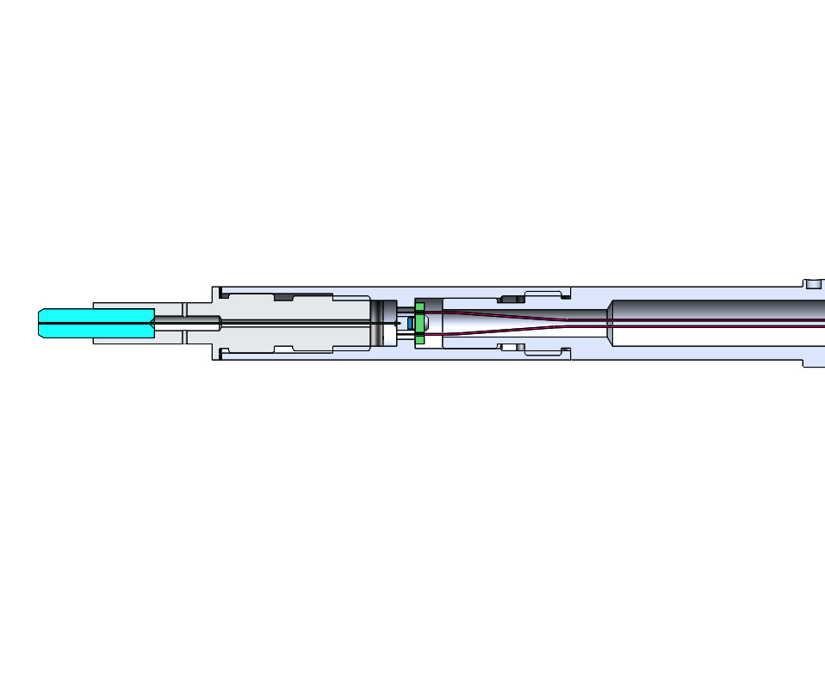
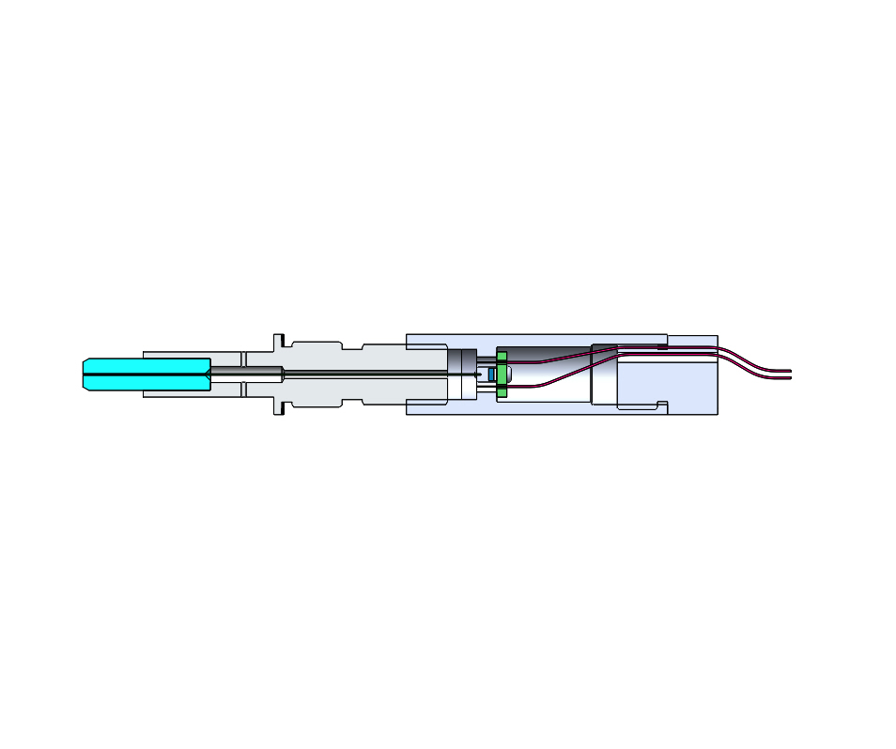
Fiducial Front end
470 NM SMT LED
(AVAGO HSMN-C170 OR EQUIVALENT)
CERAMIC
FERRULE
GLUE PORT
SMALL BOARD (SCREWED ON)
FIF
PIGTAIL
SINGLE-MODE FIBER
(LENGTH 39.6 MM)
GIF

Slide 39
Ceramic Fiber Ferrule

Slide 40
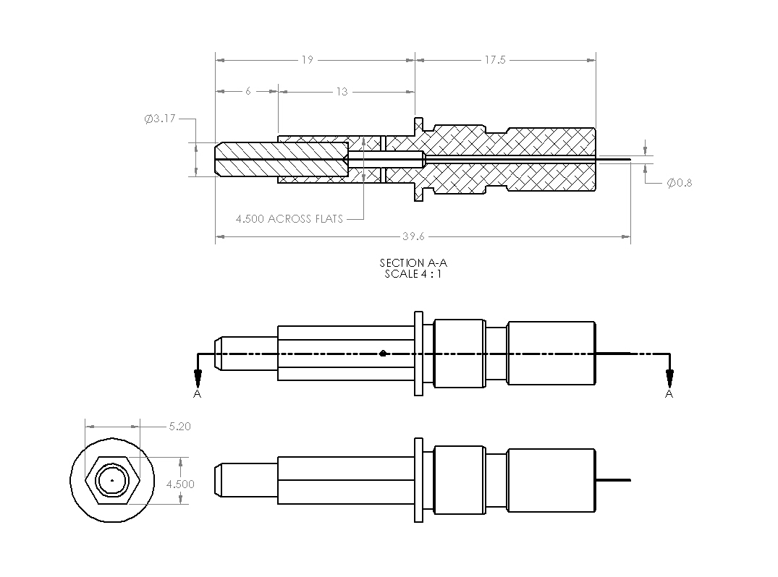
Illuminated Fiducial Fiber Tips
GLUE PORT
CERAMIC
FERRULE
SINGLE-MODE FIBER
(LENGTH 39.6 MM)

Slide 41
Tip of Illuminated Fiducial
Joe Silber

Slide 42
Backup slides

Slide 43
CCD Choice
Considered 4 Frontside Illuminated, Monochrome Sensors
CCD | Array | Pixel Size | Price
Kodak KAF-50100 | 6K x 8K | 6 μ x 6 μ | 5 K$
DALSA FTF-6080M | 6K x 8K | 6 μ x 6 μ | 25 K$
BAE (Loral) CCD-595 | 9K x 9K | 9 μ x 9 μ | 55 K$
STA STA-1600A | 10K x 10K | 9 μ x 9 μ | 50-60 K$

Slide 44
Lens Choice
Lens | Field of View | Resolution | Price
Canon EF 600mm f/4L USM | 6 º | 125 lines/mm | 13 K$
Canon EF 400mm f/5.6 DO IS USM | 6º | 125 lines/mm | 1.3 K$
Canon EF 400mm f/2.8 L IS II USM | 6º | Better then the f/5.6 | 11.5 K$
Schneider Apo-Tele-Xenar 400mm f/5.6 | 29º | 50 lines/mm | 2.4 K$
Rodenstock Apo-Sironar S 360mm f/6.8 | 40º | 76 lines/mm | 4.4 K$

Slide 45
Electronics and Package Choice
Camera | CCD Used | Array/Pixels | Price *
FLI Proline PL50100 | Kodak KAF 50100 | 6K x 8K/ 6μ | 21K$
Illunis RMV-50M | Kodak KAF 50100 | 6K x 8K/ 6μ | 30K$
Spectral Instr 1100S | Kodak KAF 50100 | 6K x 8K/ 6μ | 40K$
Spectral Instr 1110S | Loral CCD 595 | 9K x 9K/ 9μ | 150K$
STA Custom Camera Mega-Vision E7 Cam Back | STA 1600A Kodak KAF 50100 | 10K x 10K/ 9μ 6K x 8K/ 6μ | 75 – 150K$ 24K$
* Prices include the CCD

Slide 46
Focal length of FVC Lens for Proto-DESI
FVC to Focal Plane Dist | Lens Focal Length | Demag | Precision on CCD | Precision on Fiber Plane
8.9 m | 400 mm | ~21 | 0.12 μ | 2.5 μ
12.5 m | 600 mm | ~20 | 0.12 μ | 2.4 μ
12.5 m | 400 mm | ~30 | 0.12 μ | 3.6 μ
> Prototype FVC with 400 mm lens exists.
> Would prefer the 600 mm lens
for Proto DESI, as planned for
the real thing
> If money is tight, the 400 mm lens
will work fine

Slide 47
Dependence on the Number of Fiducials
Used real data of 36 exposures with the Fiber View Camera with 64 fibers each. Selected 16 fibers as fiducials to fit the 10 coefficients in x and 10 coefficients in y in the third order polynomial transformation for each exposure. Found the resolution on the fiber plane for the remaining fibers not used as fiducials to be about 2.5 microns.
Repeated using N fibers as fiducials with N from 16 to 48. With N above 30 or so resolution of the non-fiducial fibers approached 2.0 microns, as good as we have ever seen.
With only 64 fibers the number of non fiducial fibers becomes small as N is larger( 14 for N=48) so statistics not terrific.

Slide 48
Dependence on the Number of Fiducials
Simulated 5000 fibers on full 95 cm dia fiber plane
Divided fiber plane into 5000 fiber areas on hex pattern
Picked random location for each fiber in its area. These were the “TRUE” fiber center locations
Mapped fiber positions onto CCD plane by 3rd order polynomial transformation similar to actual lens/camera transformation
Spread fiber positions randomly by 13 millipixels on CCD (this corresponds to 1.9 microns on fiber plane)
Chose N fibers as fiducials, used these fiducials to obtain 3rd order polynomial to transform fibers to fiber plane
X = a₁+a₂x+a₃y+a₄xy+a₅x²+a₆y²+a₇x³+a₈y³+a₉x²y+a₁₀xy²
Y = b₁+b₂x+….
Compared these transformed positions to the known starting “TRUE” positions

Slide 49
Resolution on Fiber Plane vs. no of Fiducials
RMS on fiber plane, microns
Number of fiducials N

Slide 50
Fiber Separation Study
Measured resolution on the fiber plane for simulated
fibers at various separations, 20 at each separation
0.75mm x 1/25 demag=30μ on CCD
30μ on CCD=5 pixels=3 image FWHM
Resolution on fiber plane(μ)
2 μ
Center to center fiber separation (mm)

Slide 51
Dependence on the Flux
2 ADU counts = 1 electron
FWHM/√N
Resolution on fiber plane (microns)
Flux in image (units of 10³ ADU counts)

Slide 52
Dependence on the Flux
There is a wide plateau between 20,000 and 80,000 ADU counts that give resolution better the 2.5μ at f/16.
With 2 ADU counts/electron this means between 10,000 and 40,000 e per image on CCD, so 25,000 is a good guess of where we should be.
Our original estimate was 75,000 e per image at f/5.6. With the smaller aperture at f/16 will still need more light out of the fibers.

Slide 53
Possible Effect of Turbulence
Did one test to simulate turbulence in the Mayall telescope
Opened shades on windows, let the sunshine in. This heated up the sunnyside of the sewer pipe by up to 5ºC
Took 20 exposures at ΔT = 1ºC and at ΔT = 5ºC
No significant increase in the image FWHM at f/16
f stop | Previous resolution | ΔT = 1ºC | ΔT = 5ºC
f/16 | 2.22 μ | 2.06 μ | 2.49 μ

Slide 54
Fiber Illumination Input Angle
No effect on resolution on fiber plane
Illumination Angle | σ (x) microns | σ (y) microns
Sideways (4 exposures) | 2.09 | 2.35
Normal (6 exposures) | 2.11 | 2.47
Sideways (4 exposures) | 2.15 | 2.08

Slide 55
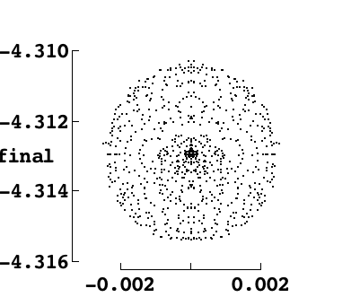
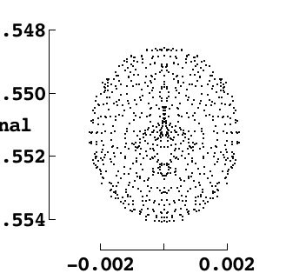
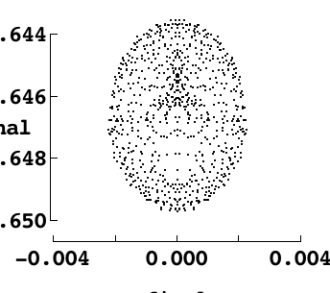
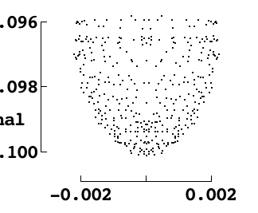
Image Shapes at various Radii
R = 100
R = 200
R = 0
-8
X
X
X
-8
-8
-8
Y
Y
Y
R = 300
R = 415
-12
-17
X
-12
X
-17
-12
-17
-12
Y
Y
Not including diffraction effects
16

Slide 56
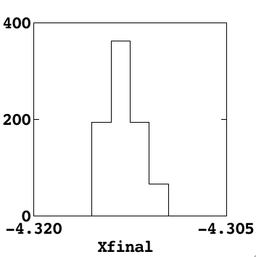
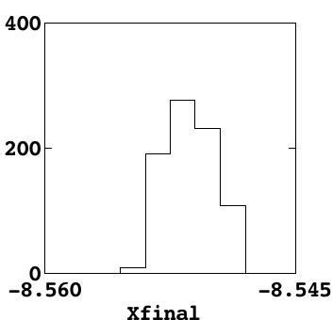
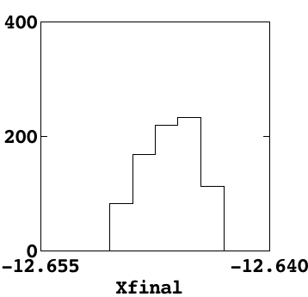
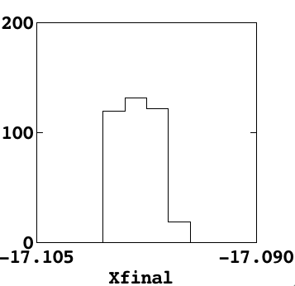
Radial Image Sizes
R = 0
R =100
R = 200
R = 300
R = 415

Slide 57
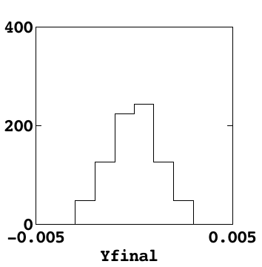
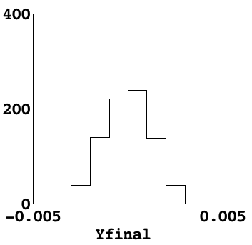
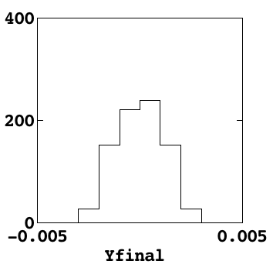
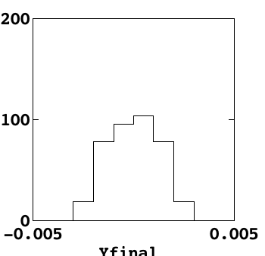
Image Sizes in Azimuth
R = 0
R = 100
R = 200
R = 300
R = 415

Slide 58
Fiber View Camera with Proto-DESI
The beam trace simulations of the Fiber View Camera were done with the DESI corrector optics to show that good images and low radial distortion can be obtained.
For the Proto-DESI run in 2016 the DESI corrector optics will not be available. The existing Mosaic corrector optics on the Mayall 4m will be used instead.
The beam trace simulations have been repeated with the Mosaic corrector.
Acceptable image quality and low radial distortion are possible.

Slide 59
Fiber View Camera with Proto-DESI
A focal plane with a diameter of 176.6 mm has been assumed
The Fiber View Camera location is taken to be Just below the center of the primary mirror, the same as in final DESI design.

Slide 60
zvertex index curvature diameter
----:- ----------:----------:------------:---------:
1 : 9.10 : 1.0 : : 176 :
2 : 95.61 : 1.0 : : 231 :
3 : 124.21 : 1.4585 :-2.757328e-3 : 231 :
4 : 410.01 : 1.0 : : 280 :
5 : 423.12 : 1.5186 : : 280 :
6 : 436.62 : 1.53171 : : 280 :
7 : 446.01 : 1.0 : : 280 :
8 : 458.99 : 1.5186 : : 280 :
9 : 471.58 : 1.53171 : : 280 :
10 : 537.76 : 1.0 :-4.310902e-3 : 277 :
11 : 552.84 : 1.4585 :-1.207117e-3 : 310 :
12 : 679.98 : 1.0 :-3.585643e-3 : 349 :
13 : 719.83 : 1.4585 :-3.748688e-3 : 380 :
14 : 721.33 : 1.0 :-1.178745e-4 : 400 :
15 : 761.13 : 1.4585 :-7.247069e-4 : 420 :
16 :11546.1543 : 1.0 : 3.83734e-3 : 120 :
17 :11586.5391 : 1.7918 : 0.02730e-3 : 120 :
18 :11632.7598 : 1.0 :-2.17879e-3 : 120 :
19 :11650.0674 : 1.7039 : 4.17718e-3 : 120 :
20 :11673.1445 : 1.0 : : 37.5 :
21 :11720.0010 : 1.0 :-0.17231e-3 : 120 :
22 :11737.3086 : 1.6068 : 1.82554e-3 : 120 :
23 :11777.6934 : 1.7918 :-3.00303e-3 : 120 :
24 :12301.74162: 1.0 : : 37 :
BEAM4 Ray Trace
Fiber View Camera
with 600 mm lens
Mayall 4m Telescope
With existing Mosaic
Corrector optics

Slide 61
Image shapes on CCD
Point source at center of
Focal plane R = 0 cm
Image sizes ~ 4 microns
(units are mm)
Y
X final

Slide 62
Image shapes on CCD
Point source near edge of
Focal plane R = 10 cm
Image sizes ~ 4 microns
(Units are mm)

Slide 63
Radial Linearity
R is the distance from the center of the CCD in mm
R on CCD (mm)
Distance from Center on Fiber Plane (mm)

Slide 64
Radial Distortion
Deviation from Linear (mm)
Distance from Center on Fiber Plane (mm)

Slide 65
Plan similar to final DESI
Image sizes of ~4 microns are too small for good centroid interpolation with 6 micron pixels. Plan to use the FVC lens at f/16 so that the diffraction limit of ~10 microns, or 1.6 pixels, gives the best centroiding precision and great stability.
The radial distortion is much smaller for Proto-DESI then for the final DESI, mostly because of the smaller focal plane diameter, so the same correction algorithm that are planned for final DESI should work fine for Proto-DESI.

